Slide 1
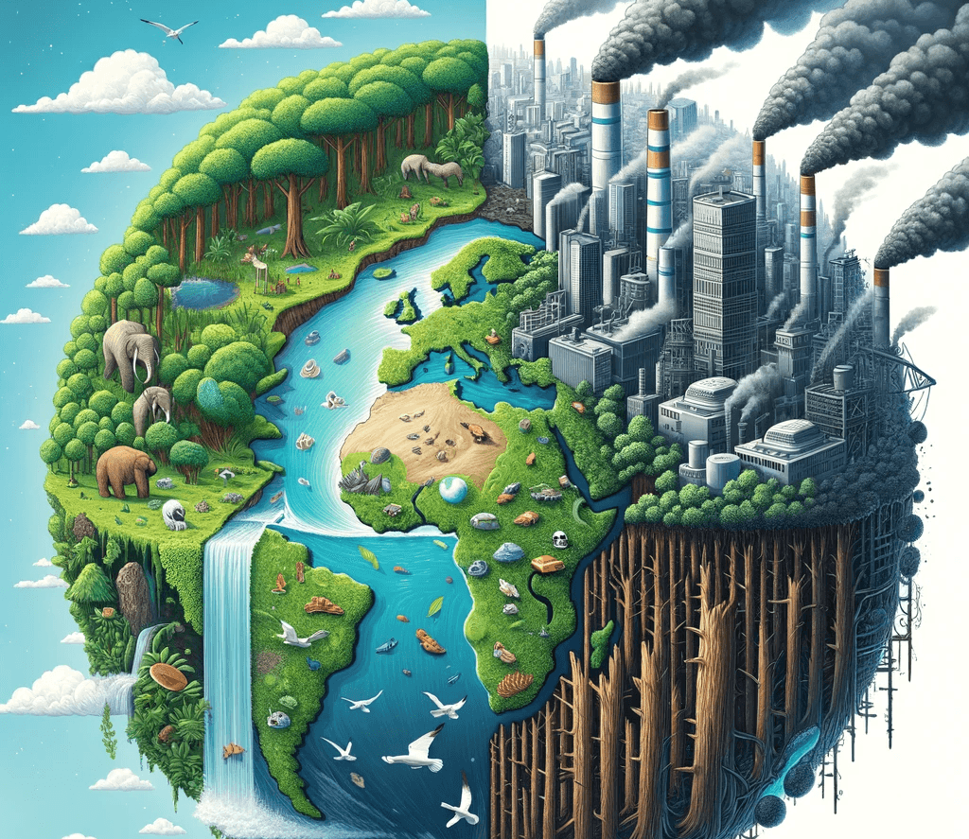
Global Warming
Presented By,
Md. Hasibul Hasan Hridoy
Department of Oceanography, SUST
Masters' 2nd semester
Session- 2022-23

Slide 2
Introduction to Global Warming
Definition: The long-term heating of Earth due to human activities.
Key drivers: Greenhouse gases, deforestation, industrial activities.
Importance: Impacts on ecosystems, economies, and human health.
Supporting visuals: Graph of temperature rise over decades with key milestones marked.
Quote: "Global warming is not a prediction. It is happening." - James Hansen

Slide 3
Causes of Global Warming
Natural Causes:
Solar activity influencing short-term climate variations.
Volcanic eruptions emitting particulate matter and gases.
Anthropogenic Causes:
Burning of fossil fuels: Includes data on coal, oil, and gas usage trends.
Agriculture and livestock: Methane from cattle and rice paddies.
Land-use changes: Deforestation leading to loss of carbon sinks.
Visuals:
Pie chart showing percentage contributions of different causes to greenhouse gases.

Slide 4

The Greenhouse Effect
Definition and Process:
Greenhouse gases trap heat in Earth's atmosphere, maintaining Earth's temperature.
Key gases: CO2, CH4, N2O, and water vapor, with explanation of their roles.
Importance of balance: The necessity for life and the dangers of its amplification.
Diagram: Detailed illustration of the greenhouse effect with arrows showing solar radiation and heat trapping.

Slide 5
Key Greenhouse Gases
Carbon Dioxide (CO2): Fossil fuel burning, deforestation trends with global emission statistics.
Methane (CH4): Key sources such as livestock and natural gas extraction.
Nitrous Oxide (N2O): Fertilizers and industrial activities.
Chlorofluorocarbons (CFCs): Explanation of their past and residual effects.
Pie Chart: Contribution of each gas to global warming, highlighting CO2 dominance.

Slide 6

Evidence of Global Warming
Data: Rising global temperatures over the past century .
Visuals: Melting polar ice caps and glaciers (before-and-after images).
Rising sea levels (map showing affected coastal cities).
Increased frequency of extreme weather events: Heatwaves, hurricanes.
Supporting data from IPCC reports and NASA studies.

Slide 7
Impacts on Ecosystems
Habitat Disruption: Species extinction due to changing environments.
Coral Bleaching: Effects of rising ocean temperatures and acidity.
Migration and Breeding: Shifts in animal patterns, with case studies (e.g., polar bears, birds).
Visuals: Before-and-after photos of impacted ecosystems and wildlife.

Slide 8

Impacts on Human Health
Heatwaves: Rising mortality rates and vulnerable populations.
Vector-borne Diseases: Spread of diseases like malaria and dengue due to temperature changes.
Food and Water Scarcity: Impacts on agriculture and freshwater sources.
Case Study: Heatwave deaths in Europe (2003) and their lessons.

Slide 9
Economic Impacts
Infrastructure Damage: From hurricanes, floods, and wildfires.
Agricultural Losses: Decreased crop yields, increased pests.
Fisheries: Decline in fish stocks due to warming oceans.
Visuals: Economic loss graphs and examples of impacted industries.

Slide 10
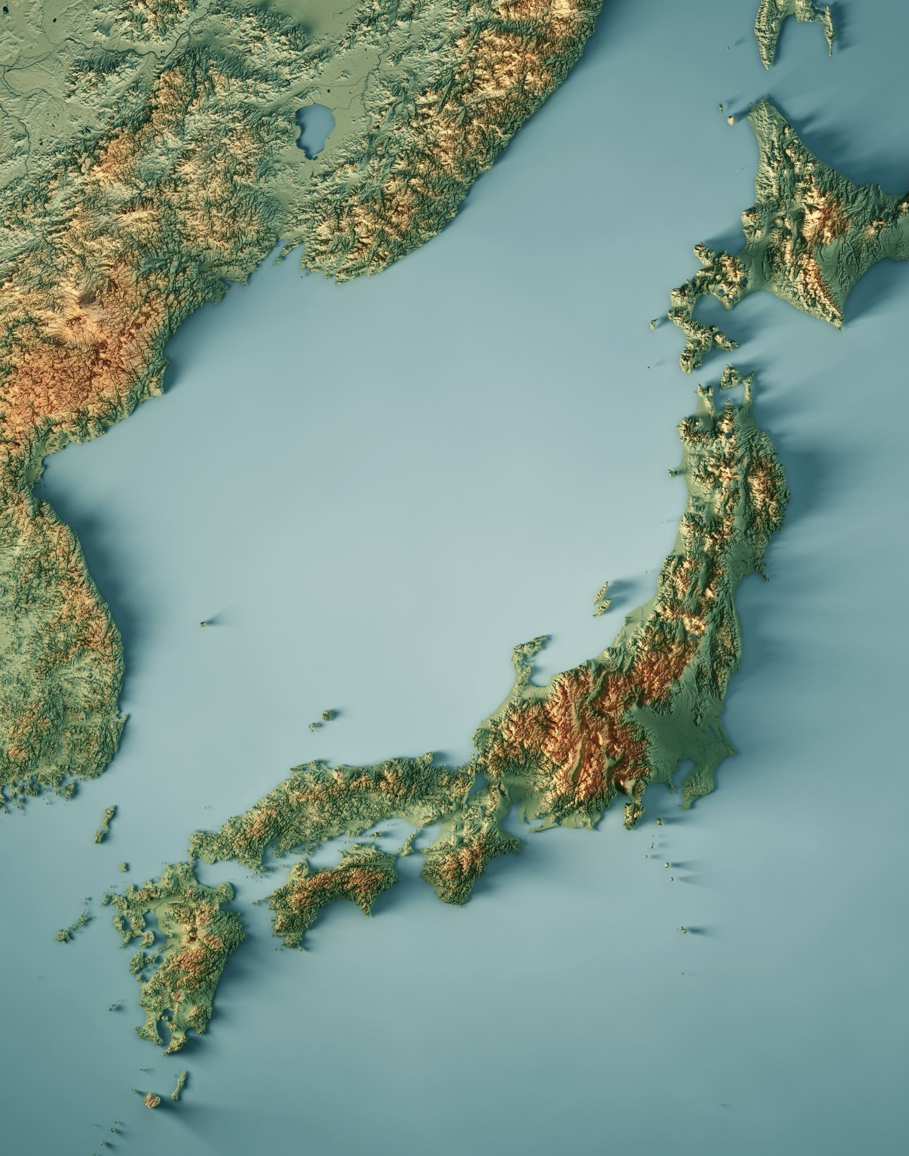
Regional Variations
Vulnerable Regions:
Arctic: Melting ice and permafrost.
Small Island Nations: Risk of submersion.
Coastal Areas: Flooding and storm surges.
Unequal Impacts: Comparison between developed and developing nations.
Map: Regions most affected by global warming.

Slide 11
International Agreements
Kyoto Protocol: Overview of goals and achievements.
Paris Agreement
Goals: Keeping warming below 2°C.
Contributions: Each nation's commitment.
Challenges: Political resistance and accountability.
Timeline: Evolution of climate agreements from 1990 to present.

Slide 12
Mitigation Strategies
Renewable Energy: Growth of solar, wind, and hydroelectric energy production.
Efficiency Improvements: Examples in buildings, appliances, and industries.
Carbon Capture: Innovations and scalability challenges.
Success Stories: Germany's renewable energy progress.

Slide 13
Role of Governments
Policies: Subsidies for green energy, penalties for high emissions.
Green Infrastructure: Public transport systems, energy-efficient housing.
Examples: Norway’s electric vehicle incentives.

Slide 14
Role of Businesses
Corporate Responsibility.
Carbon-neutral goals.
Green supply chains.
Innovations: Renewable packaging, waste reduction.
Visuals: Case studies from Tesla, Unilever, and Patagonia.

Slide 15
Role of Individuals
Reducing Carbon Footprints.
Switch to public transport or biking.
Reducing meat consumption.
Energy-saving practices: LED lights, efficient appliances.
Interactive: Calculator for individual carbon footprint.

Slide 16
Advances in Technology
Renewable Energy: Breakthroughs in solar panel efficiency.
Electric Vehicles: Adoption trends and battery innovations.
Climate Modeling: AI-driven predictive models.
Visuals: Examples of cutting-edge technology in use.

Slide 17
Success Stories
Countries achieving carbon neutrality: Bhutan.
Companies: Apple’s renewable energy supply chain.
Community Initiatives: Urban farming projects.
Metrics: CO2 reductions achieved.

Slide 18
Challenges to Address
Political Resistance: Case studies of policy rollbacks.
Financial Barriers: Cost of transitioning to renewable energy.
Public Awareness: Gap between knowledge and action.
Overcoming Barriers: Potential policy and grassroots solutions.

Slide 19
Future Projections
IPCC Projections: Temperature and sea level rise by 2100.
Tipping Points: Arctic ice melt, Amazon dieback.
Graphs: Predictive models based on emissions scenarios.

Slide 20
Importance of Education
Climate Literacy: Programs in schools and universities.
Community Outreach: Workshops and local initiatives.
Case Study: Role of media campaigns in raising awareness.

Slide 21
Role of Media
Informing the Public: Highlighting scientific findings and solutions.
Advocacy: Campaigns to hold entities accountable.
Examples: Documentaries like "An Inconvenient Truth."

Slide 22
Role of NGOs and Advocacy
Grassroots Movements: Examples of impactful campaigns.
Accountability: Pushing for transparency and action.
Success Stories: Greenpeace, WWF initiatives.

Slide 23
Community Actions
Local Projects: Reforestation drives, waste management initiatives.
Urban Green Spaces: Benefits and case studies.
Visuals: Photos of successful community projects.

Slide 24
Youth and Activism
Global Movements: Fridays for Future, Greta Thunberg’s influence.
Platforms: Social media’s role in youth activism.
Empowering Stories: Young leaders making change.

Slide 25
Financial Solutions
Green Bonds: Funding renewable projects.
Carbon Taxes: Incentivizing emission reductions.
Role of Banks: Financing climate-resilient infrastructure.

Slide 26
Innovations in Science
Geoengineering: Strategies like solar radiation management.
Advances: New materials for carbon capture.
Risks: Ethical and unintended consequences.

Slide 27
Hope for the Future
Resilience: Communities adapting to challenges.
Innovations: Rapid development in sustainable technologies.
Collective Power: Examples of large-scale successes.

Slide 28

Call to Action
Immediate Steps: Simple actions individuals can take.
Long-term Goals: Pushing for systemic changes.
Inspirational Quote: "The Earth is what we all have in common." - Wendell Berry

Slide 29

Key Takeaways
Urgency of addressing global warming.
Collective Action: Everyone has a role.
Innovation and Education: Key drivers for solutions.

Slide 30

THANK YOU

